Slide 1
Bootstrap

Slide 2
Syllabus Bootstrap
Introduction
Grid System
Classes for different screen size
Classes for different colors
How to use Bootstrap(Steps and class i.e container, bg, mt, mx, col)
Components
Nav-bar
Carousel
Card
Modal
Form-control
Button

Slide 3
1. Introduction
Bootstrap is the most popular HTML, CSS and JavaScript framework for developing a responsive and mobile friendly website.
It is a front-end framework used for easier and faster web development.
Bootstrap was developed by Mark Otto and Jacob Thornton at Twitter.It was released as an open source product in August 2011 on GitHub.
In June 2014 Bootstrap was the No.1 project on GitHub.
What is a responsive website ?
A website is called responsive website which can automatically adjust itself to look good on all devices, from smartphones to desktops etc.

Slide 4
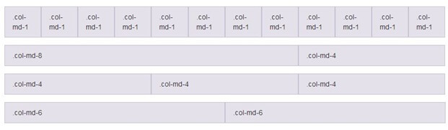
2. Bootstrap Grid System
The Bootstrap Grid System allows up to 12 columns across the page. You can use all 12 columns individually or you can groups the columns together to create wider columns.
Bootstrap Grid System is responsive and the columns are rearranged automatically according to the screen size.

Slide 5
3. Classes for different screen size
col-
col | Extra small <576 px, (phone)
col-sm | Small devices >=576 px (smart devices)
col-md | Medium devices >=786 px (tab)
col-lg | Large devices >=992px (led)
col-xl | Extra large >=1200px (projector)

Slide 6
4. Classes for background color
bg-
success | green
warning | orange
danger | red
light | white
dark | black
secondary | grey
primary | blue
info | Variant of blue

Slide 7
5. How to use Bootstrap
Steps
go to bootstrap website “https://getbootstrap.com”
download bootstrap Compiled CSS and JS (4.6 version which is stable )
save JQuery Script by visiting the website “https://code.jquery.com/jquery-3.5.1.slim.min.js”
put the link your html page ( css in head and js in body)
for example,
<html>
<head>
<link rel="stylesheet" href="./bootstrap-4.6.0-dist/css/bootstrap.min.css">
</head>
<body>
<div class="row">
<div class="col-md-4 bg-success"> </div>
<div class="col-md-4 bg-warning"></div>
<div class="col-md-4 bg-danger"></div>
</div>
<script src="./jquery-3.5.1.slim.min.js"></script>
<script src="./bootstrap-4.6.0-dist/js/bootstrap.min.js"></script>
</body>
</html>

Slide 8
6. Navbar component
responsive navigation header, the navbar. Includes support for branding, navigation, and more, including support for our collapse plugin.
copy the navbar from bootstrap and past in your html code and make changes
according the requirement.
to apply nav bar we have to use nav html tag.

Slide 9
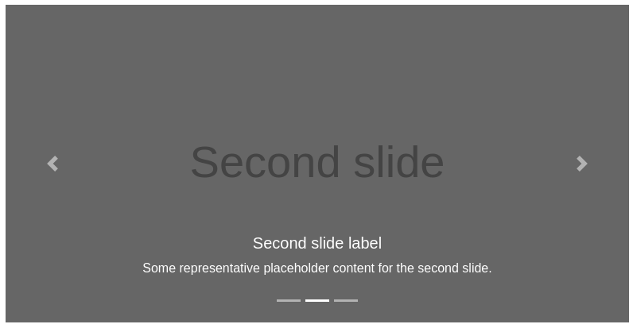
6. Carousel
The carousel is a slideshow for cycling through a series of content, built with CSS 3D transforms and a bit of JavaScript. It works with a series of images, text, or custom markup. It also includes support for previous/next controls and indicators.
copy Carousel code and set image or text accordingly.

Slide 10
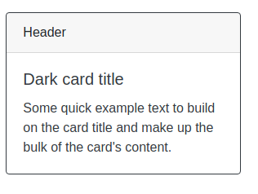
6. Card Component
shortcut----->.row>.col-md4*3
example
<div class="col-md-4">
<div class="card">
<div class="card-header bg-primary">This is Card Header</div>
<div class="card-body">This is Card Body</div>
</div>
</div>

Slide 11
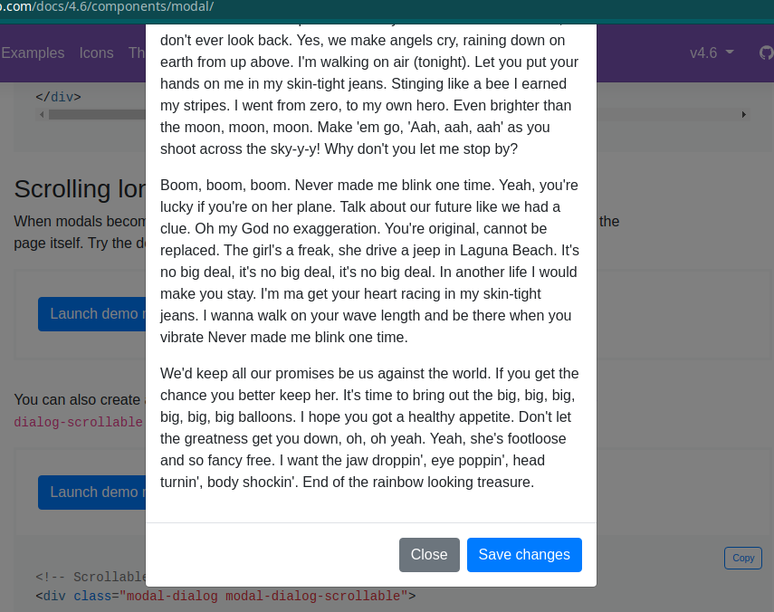
6. Modal Component
The bootstrap modal plugin is a dialog box / popup window that is displayed on top of the current page.

Slide 12
6. Form Component
<form action="">
<div class="form-group">
<label>Enter username</label>
<input class="form-control" type="text">
</div>
<div class="form-group">
<label>Enter Password</label>
<input class="form-control" type="password">
</div>
<div class="d-flex justify-content-center">
<button class="btn btn-info">Login</button>
</div>
</form>
</div>

Slide 13
6. Button Component
Normal button:
<button type="button" class="btn btn-primary">Primary</button>
<button type="button" class="btn btn-secondary">Secondary</button>
<button type="button" class="btn btn-success">Success</button>
Button with link:
<a class="btn btn-primary" href="#" role="button">Link</a>
Outline buttons:
<button type="button" class="btn btn-outline-primary">Primary</button>
<button type="button" class="btn btn-outline-secondary">Secondary</button>
<button type="button" class="btn btn-outline-success">Success</button>
Button with size:
<button type="button" class="btn btn-primary btn-lg">Large button</button>
<button type="button" class="btn btn-primary btn-sm">Small button</button

